Slide 1
Cepheid
BACKGROUND: CEPHEID JUST INVESTED IN A NEW PRODUCTION LINE (VFAL) WHICH MANUFACTURE PRODUCT 24 HOURS PER DAY
PROBLEM : EFFICIENT CONTROL AND MONITORING DATA COMING OUT FROM THAT PRODUCTION LINE FOR STATISTICS AND DOCUMENTATION
SOLUTION: PRODUCTION ANALYTICS MONITORING SYSTEM

Slide 2
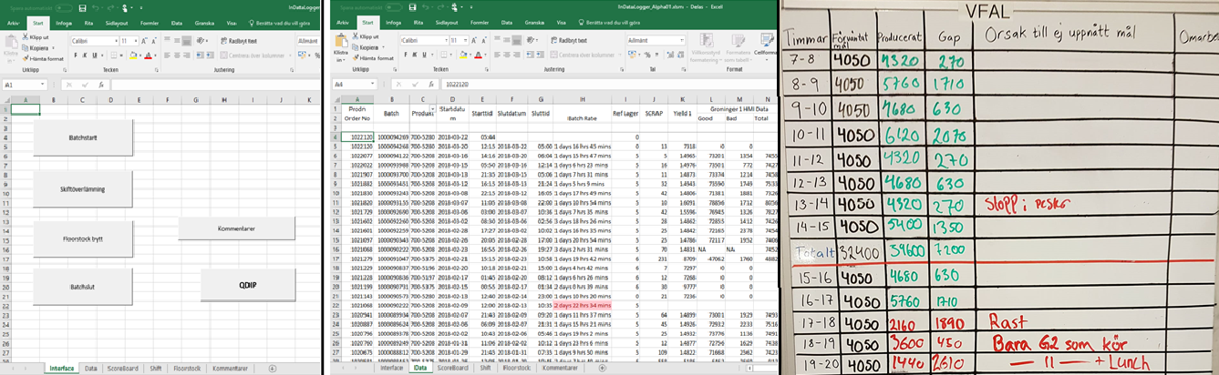
Current gui

Slide 3
VFAL Monitor Requirements
2 parts to the application:
Operations – Data input, used by operators in production
Statistics – Data visualization, used by managers and planners
Operators should spend minimal time using the application. Input of data should be efficient and intuitive.
The application should never hinder or reduce production speed.
Managers and planners want data statistics on everything!

Slide 4
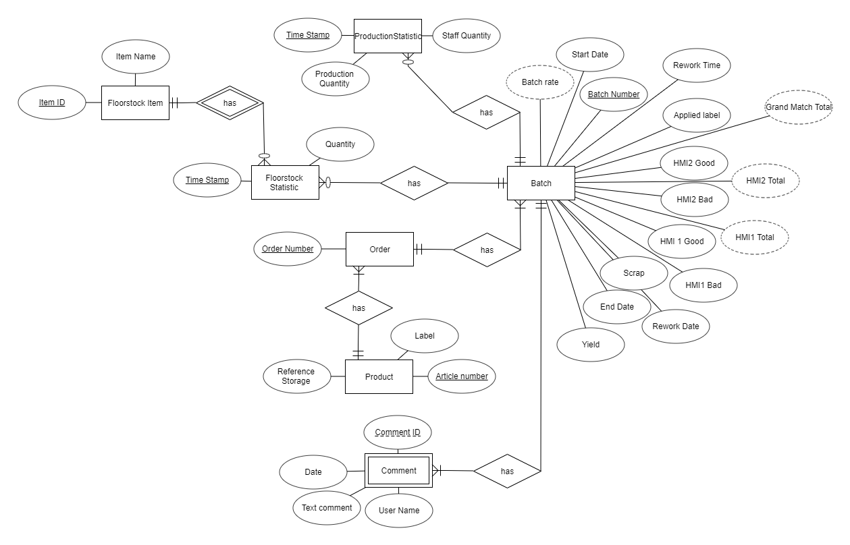

Slide 5
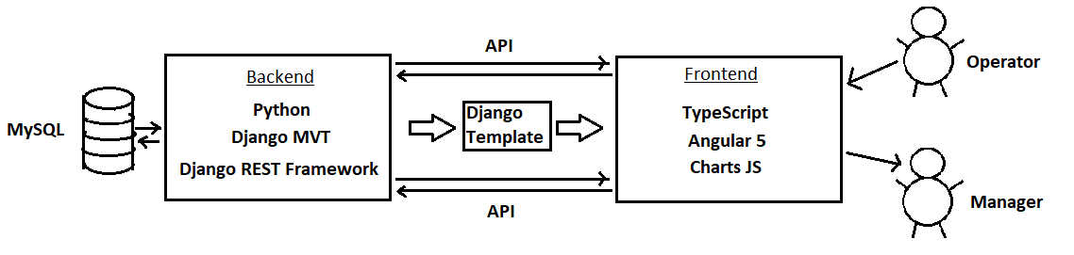
Architechture → Tools → Implementation
Django Backend for the API
Separate Angular Frontend served by ONE Django template
Django for rapid, simple development. Angular for guaranteed scalability.

Slide 6
Subscription issue:
Due to => Asynchronous Http Calls Angular 5 not waiting for response
Current solution => Angular is waiting in the ‘get call handle’ and we are transforming the data there, and other more "ad hoc" solutions
Solution => Ex. using RxJS pipes and mapping => so far too complicated for us
Also => Solve/manage by changing APIs, page and ‘get call’ design

Slide 7
Issue with lazy loading:
Bug in Angular 5?
Documentation lacking in general..
Lazy loading => Boost performance not loading everything at once.
Problem with => Routing to child modules
Management => implementing a semi – solution, not working with scale up.
Solution => Not implementing but we have to change file structure for this

